Slide 1
Marketing Analytics
Saloman Londhe

Slide 2
Introduction to Business Problem
Decathlon, an online retail business, is facing reduced customer engagement and conversion rates despite launching several new online marketing campaigns. They are reaching out to you to help conduct a detailed analysis and identify areas for improvement in their marketing strategies.
Key Points:
  Reduced Customer Engagement: The number of customer interactions and engagement with the site and marketing content has declined.
  Decreased Conversion Rates: Fewer site visitors are converting into paying customers.
  High Marketing Expenses: Significant investments in marketing campaigns are not yielding expected returns.
  Need for Customer Feedback Analysis: Understanding customer opinions about products and services is crucial for improving engagement and conversions

Slide 3
Subject: Request for Data Analysis to Improve Marketing Strategy
Hi Data Analyst,
I hope this email finds you well. I’m the Marketing Manager at Decathlon. We’ve been facing some challenges with our marketing campaigns lately, and I’m reaching out to request your expertise in data analysis to help us identify areas for improvement.
Despite our increased investment in marketing, we’ve observed a decline in customer engagement and conversion rates. Our marketing expenses have gone up, but the return on investment isn’t meeting our expectations. We need a comprehensive analysis to understand the effectiveness of our current strategies and to find opportunities to optimize our efforts.
We have data from various sources, including customer reviews, social media comments, and campaign performance metrics. Your insights will be invaluable in helping us turn this situation around.
Looking forward to your response.
Best regards,
Marketing Manager

Slide 4
Subject: Request for Data Analysis to Improve Marketing Strategy
Hi Data Analyst,
I’m the Customer Experience Manager at Decathlon, and I’m writing to seek your help with analyzing our customer feedback. Over the past few months, we’ve noticed a drop in customer engagement and satisfaction, which is impacting our overall conversion rates.
We’ve gathered a significant amount of customer reviews and social media comments that highlight various issues and sentiments. We believe that by thoroughly analyzing this feedback, we can gain a better understanding of our customers' needs and pain points.
Your expertise in data analysis will be crucial in helping us decode this feedback and provide actionable insights. We hope this will guide us in improving our customer experience and ultimately boost our engagement and conversion rates.
Thank you for your assistance.
Best regards,
Customer Experience Manager

Slide 5
Key Performance Indicators (KPIs)
Conversion Rate: Percentage of website visitors who make a purchase.
Customer Engagement Rate: Level of interaction with marketing content (clicks, likes, comments).
Customer Feedback Score: Average rating from

Slide 6
Goals
Increase Conversion Rates:
  Goal: Identify factors impacting the conversion rate and provide recommendations to improve it.
  Insight: Highlight key stages where visitors drop off and suggest improvements to optimize the conversion funnel.
Enhance Customer Engagement:
  Goal: Determine which types of content drive the highest engagement.
  Insight: Analyze interaction levels with different types of marketing content to inform better content strategies.
Improve Customer Feedback Scores:
  Goal: Understand common themes in customer reviews and provide actionable insights.
  Insight: Identify recurring positive and negative feedback to guide product and service improvements.

Slide 7
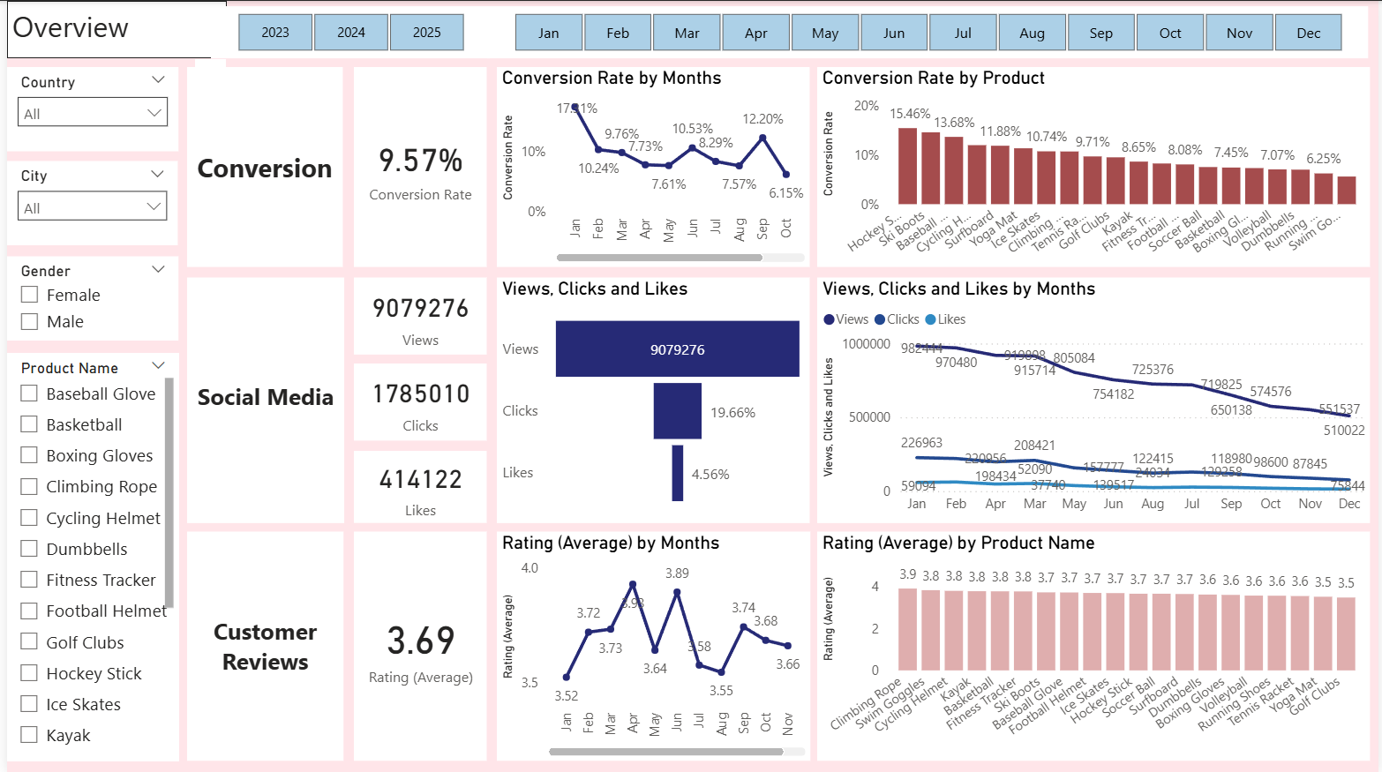
Overview
Decreased Conversion Rates: The conversion rate demonstrated a strong rebound in June, reaching 10.53% and in the month of September 12.20% due to increase in adventure activities.
Reduced Customer Engagement:
  There is a decline in overall social media engagement, with views dropping throughout the year.
  While clicks and likes are low compared to views, the click-through rate stands at 19.66%, meaning that engaged users are still interacting effectively.
Customer Feedback Analysis:
  Customer ratings have remained consistent, averaging around 3.69 throughout the year.
  Although stable, the average rating is below the target of 4.0, suggesting a need for focused improvements in customer satisfaction, for products below 3.5 rating.

Slide 8
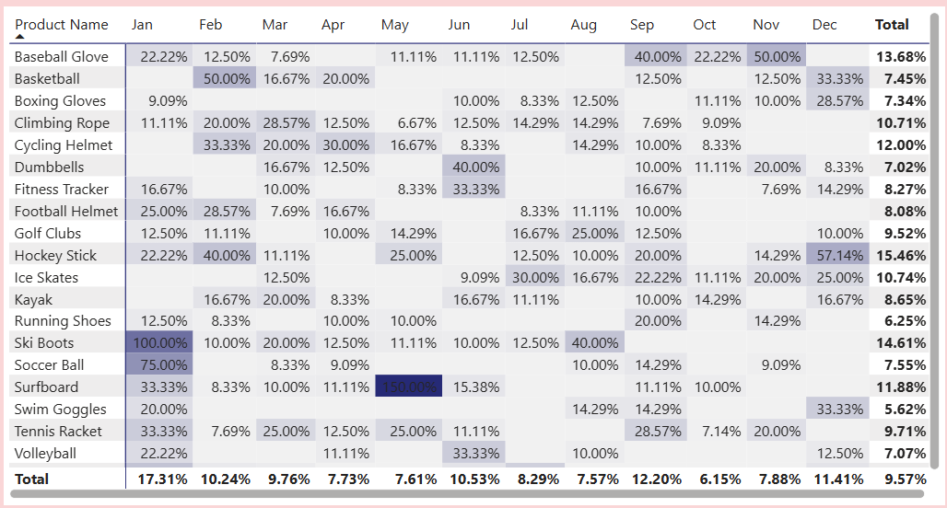
Decreased Conversion Rates
General Conversion Trend:
  Throughout the year, conversion rates varied, with higher numbers of products converting successfully in months like January, February, March, June and December. This suggests that while some products had strong seasonal peaks, there is potential to improve conversions in lower-performing months through targeted interventions.
Lowest Conversion Month:
  October experienced the lowest overall conversion rate at 6.15%, with no products standing out significantly in terms of conversion. This indicates a potential need to revisit marketing strategies or promotions during this period to boost performance.
Highest Conversion Rates:
  January recorded the highest overall conversion rate at 17.31%, driven significantly by the Ski Boots with a remarkable 100% conversion. This indicates a strong start to the year, likely fueled by seasonal demand and effective marketing strategies. There is spike in surfboard sales in May indicates surfing season.

Slide 9
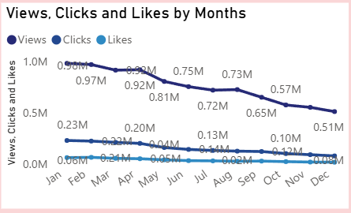
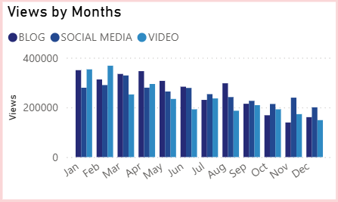
Reduced Customer Engagement
Declining Views:
  Views peaked in First Quarter of The year but declined from May and so on, indicating reduced audience engagement in the later half of the year.
Low Interaction Rates:
  Clicks and likes remained consistently low compared to views, suggesting the need for more engaging content or stronger calls to action.
Content Type Performance:
  Blog content drove the most views, especially in April and August, while social media(except Nov, Dec) and video(except March) content maintained steady but slightly lower engagement.

Slide 10
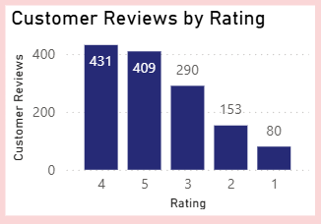
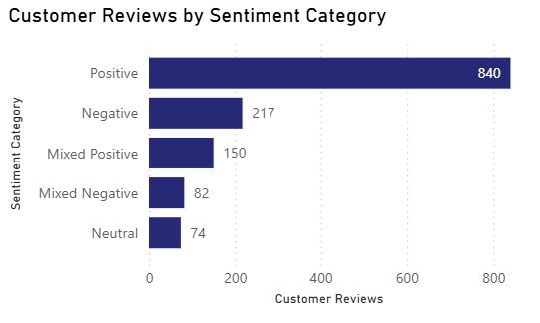
Customer Feedback Analysis
Customer Ratings Distribution:
  The majority of customer reviews are in the higher ratings, with 431 reviews at 4 stars and 409 reviews at 5 stars, indicating overall positive feedback. Lower ratings (1-2 stars) account for a smaller proportion, with 80 reviews at 1 star and 153 reviews at 2 stars.
Sentiment Analysis:
  Positive sentiment dominates with 840 reviews, reflecting a generally satisfied customer base. Negative sentiment is present in 217 reviews, with a smaller number of mixed and neutral sentiments, suggesting some areas for improvement but overall strong customer approval.
Opportunity for Improvement:
  The presence of mixed positive and mixed negative sentiments suggests that there are opportunities to convert those mixed experiences into more clearly positive ones, potentially boosting overall ratings. Addressing the specific concerns in mixed reviews could elevate customer satisfaction.

Slide 11
Goals & Actions
Goals
Actions
Increase Conversion Rates:
  Goal: Identify factors impacting the conversion rate and provide recommendations to improve it.
  Insight: Highlight key stages where visitors drop off and suggest improvements to optimize the conversion funnel.
Enhance Customer Engagement:
  Goal: Determine which types of content drive the highest engagement.
  Insight: Analyze interaction levels with different types of marketing content to inform better content strategies.
Improve Customer Feedback Scores:
  Goal: Understand common themes in customer reviews and provide actionable insights.
  Insight: Identify recurring positive and negative feedback to guide product and service improvements.
Increase Conversion Rates:
  Target High-Performing Product Categories: Focus marketing efforts on products with demonstrated high conversion rates, such as Kayaks, Ski Boots, and Baseball Gloves. Implement seasonal promotions or personalized campaigns during peak months (e.g., January and September) to capitalize on these trends.
Enhance Customer Engagement:
  Revitalize Content Strategy: To turn around declining views and low interaction rates, experiment with more engaging content formats, such as interactive videos or user-generated content. Additionally, boost engagement by optimizing call-to-action placement in social media and blog content, particularly during historically lower-engagement months (Later Half Year).
Improve Customer Feedback Scores:
  Address Mixed and Negative Feedback: Implement a feedback loop where mixed and negative reviews are analyzed to identify common issues. Develop improvement plans to address these concerns. Consider following up with dissatisfied customers to resolve issues and encourage re-rating, aiming to move average ratings closer to the 4.0 target.

